Slide 1
Guide to interact with the dashboard
The case of one FOA:
Crop Production

Slide 2
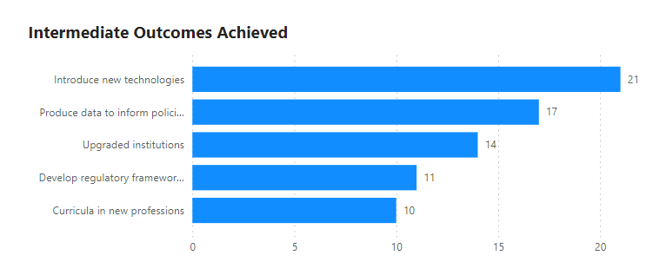
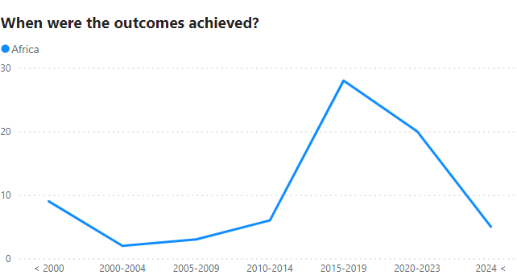
Which improvements have been introduced by TC programme in Africa?
In Africa, for the FOA “Crop Production”, the TC programme mainly contributed by introducing new technologies, and to produce data to inform policies.
The contribution of the programme in introducing improvements in Africa was more intense during the period 2015-2019.
An intermediate outcome provides an interim indication of initial uptake by programme stakeholders

Slide 3
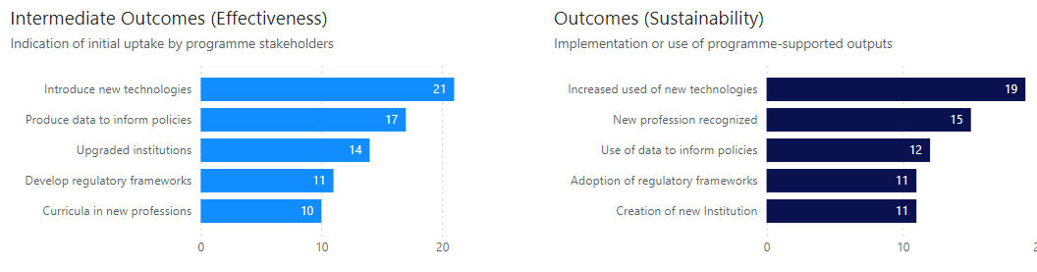
Have these improvements brought by the TC programme been adopted by the supported African countries?
In Africa, out of the 21 cases where a new technology was introduce, 19 actually increase the used of that new technology,
The data produced was used to inform policies,
The curricula in new professions, contributed to the recognition of new professions.
Note: According to the ToC, if the programme’s adopted outputs are effectively implemented by its beneficiary stakeholders, we articulate this as enhanced and sustained action.

Slide 4
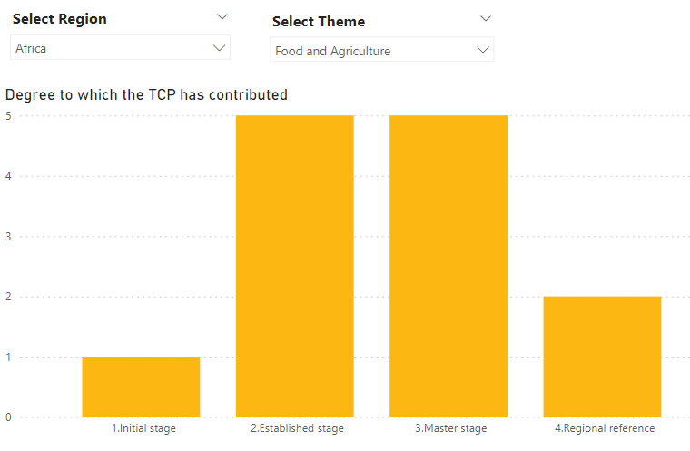
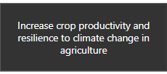
Has the TCP contributed to achieved sustainable impacts in Africa?
The TC programme has contributed to increase crop productivity and resilience to climate change in agriculture. In Africa, supported countries have reached master stage and some have even became regional references.
Countries reach sustainable impacts when they are capable for mastering a technology.

Slide 5
How did the TC programme contribute to increase the capacity of supported institutions?
The case of one FOA:
Crop Production
Informed by the CP survey

Slide 6
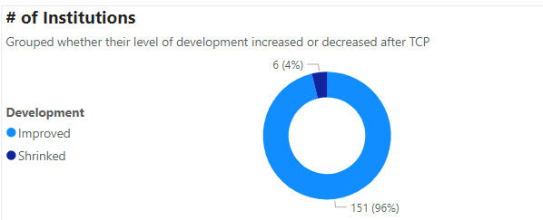
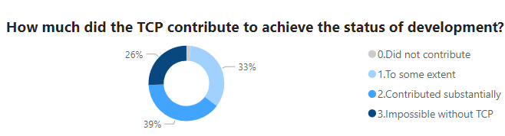
Has the TC programme contributed to improve the status of development of institutions supported in Crop Production in Africa?
96% of the institutions consider that their status of development in the use of nuclear technologies to improve crop production has improve compare to their status before being supported by the TCP.
33% consider that the improvement would have been impossible without the support of the TCP

Slide 7
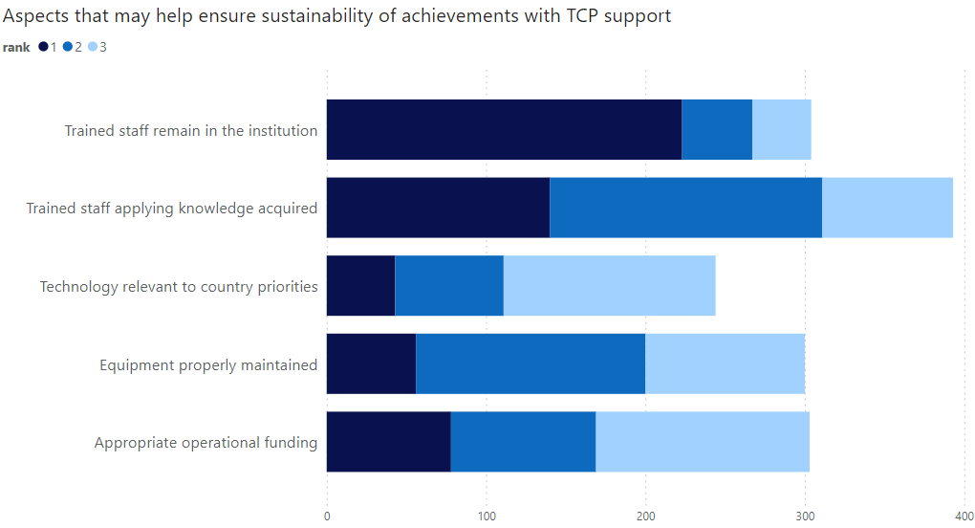
What are the aspects that may ensure the sustainability of achievements with TCP support in Africa?
According to the CPs, the main priorotity is for the trained staff to remain in the institution
It is also perceived that to ensure sustainability, the trained staff should apply the knowledge acquired by participating in the programme.

